Slide 1
Mississippi Coastal Improvements Program (MsCIP)
Comprehensive Barrier Island Restoration Plan
Ship Island Design & Construction
2016 STGEC Conference
November 10, 2016
Justin McDonald, P.E.

Slide 2
Presentation Outline
History of the Mississippi Coastal Improvements Program (MsCIP)
Development of the Comprehensive Barrier Island Restoration Plan
Investigations, Analyses, & Modeling Performed in Support of the Project
Description of Recommended Plan for Ship Island
Details of the Phase 1 Contract

Slide 3
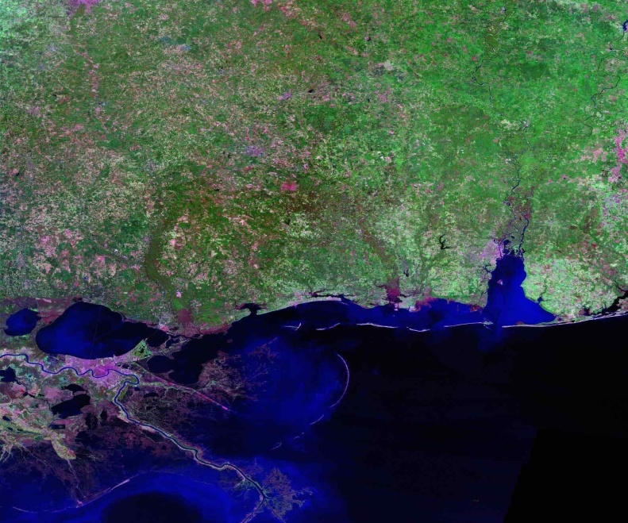
Mississippi Coastal
Improvements Program
P.L. 109-148, 30 December 2005
Comprehensive Planning to Address
  Hurricane and Storm Damage Reduction
  Salt Water Intrusion
  Shoreline Erosion
  Fish and Wildlife Preservation
  Other Water Related Resource Projects
Cost Effective Projects in lieu of NED benefits
No Incremental Benefit-Cost Analysis
Report requirements
  Interim Report within 6 months
  Comprehensive Plan within 2 years
Compatible with State Coastal Restoration Plan
Notes:
Public Law 109-148 (Third Emergency Supplemental to the DOD Appropriations Act, 2006) directed the USACE to perform a comprehensive study. Specifically the language states “conduct an analysis and design for comprehensive improvements or modifications to existing improvements in the coastal area of Mississippi in the interest of hurricane and storm damage reduction, prevention of saltwater intrusion, preservation of fish and wildlife, prevention of erosion, and other related water resource purposes at full Federal expense; Provided further, that the Secretary shall recommend a cost-effective project, but shall not perform an incremental benefit-cost analysis to identify the recommended project, and shall not make project recommendations based upon maximizing net national economic development benefits; Provided further, that interim recommendations for near term improvements shall be provided within 6 months of enactment of this act with final recommendations within 24 months of this enactment”
In addition, the comprehensive planning was to be consistent to the maximum extent possible with the State Coastal Restoration Plan.

Slide 4
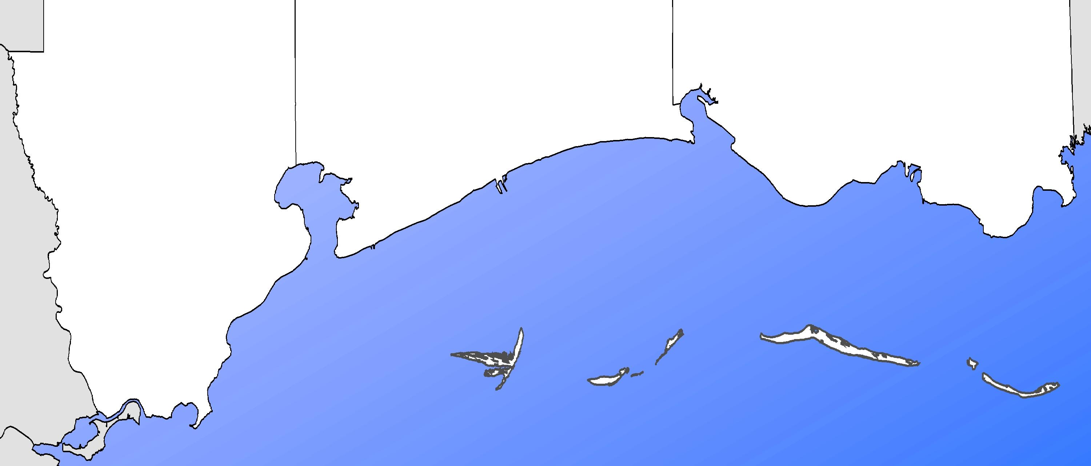

Hurricane / Storm
MsCIP Restoration Elements
Salt Water Intrusion
Shoreline Erosion
Fish & Wildlife
Interim Projects
Phase I Projects
Ecosystem Restoration Studies
Other Studies
Hancock
County
Harrison
County
Jackson
County
1
4
7
1
1
1
1
3
1
1
1
Biloxi
3
10
1
1
6
5
6
1
2
Moss Point
8
Gulfport
11
5
3
8
7
1
Gautier
3
2
1
Gulfport
3
3
4
Pascagoula
9
1
1
1
1
2
1
3
3
12
9
1
1
1
1
3
Bay St. Louis
10
1
6
1
1
1
3
Waveland
4
1
12
11
13
Petit Bois
3
15
1
Petit Bois
1
1
1
14
Horn
1
1
1
1
4
Ship
Horn
Cat
Ship
5
Cat
High Hazard Risk Area
1% Chance Flood Risk
Katrina Inundation Limits
Littoral Zone Placement of Sand
O&M Beneficial Use Placement

Slide 5
Objectives of Comprehensive Barrier Island
Restoration Plan
Restore the barrier islands structure to reduce storm damage impacts on the mainland coast of Mississippi.
Enhance the long-term littoral drift system for the Mississippi barrier islands.
Maintain the estuarine ecosystem and resources of the Mississippi Sound.
Preserve the natural and cultural resources of the Mississippi barrier islands.

Slide 6
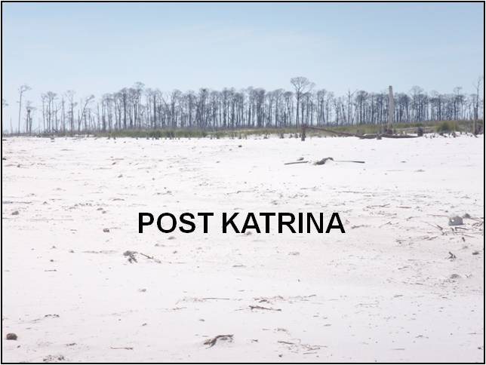
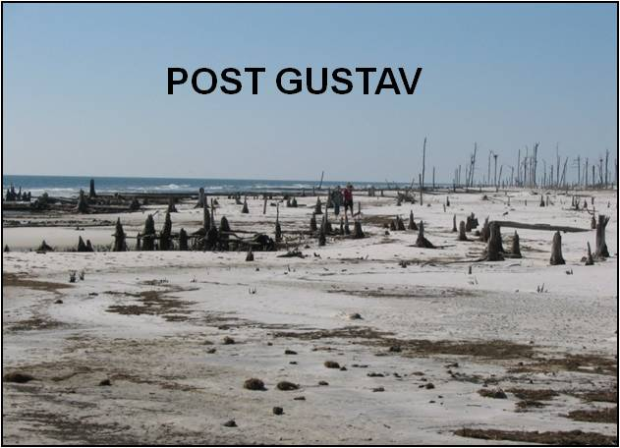
Comprehensive Barrier Island Restoration Plan Components
Sediment budget of barrier island chain
Eastern shoreline of Cat Island
Revised dredge material disposal plan for Pascagoula navigation channel
Northern shoreline of West Ship Island

Slide 7
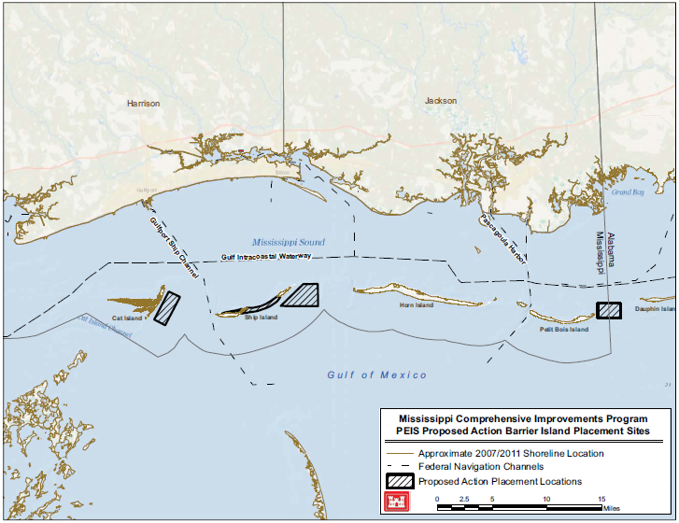
Original Placements for Restoration of
Sediment Budget – Mississippi Barrier Islands

Slide 8
Modeling/Analyses Completed in Support of the Project
Barrier Island Sediment Budget (1917/20 – 2005/10) – Applied Coastal Engineering
  Limits: Dauphin Island in the East to Cat Island in the West
Desktop Analysis – USACE, Mobile District
  Provided a relative comparison of borrow sources. Used as a screening tool to identify alternatives for further detailed analysis and modeling
Hydrodynamic, Water Quality, Wave, Sediment Transport, & Morphology – ERDC & CH2MHill/Deltares/DHV
  Circulation: ADCIRC and CH3D (ERDC)
  WQ: CH3D and CEQUAL-ICM (ERDC)
  Reduction in waves along MS coast: ADCIRC & STWAVE (ERDC)
  Nearshore sediment transport at Ship Island (1-,10-, & 500-Year Storms): C2SHORE (ERDC)
  Wave impacts of nearshore borrow areas: STWAVE & GENESIS (ERDC)
  Morphology of the restored Ship Island & impacts to Gulfport Navigation Channel for average conditions (4-year simulation) and storm events (6 hurricanes): Delft-3D (CH2/Deltares/DHV)
  Recovery potential of the restored Ship Island to storm events: Delft-3D (CH2/Deltares/DHV)
  Optimization of construction methods (profile design, sand losses, and turbidity): Delft-3D & Unibest-TC (CH2/Deltares/DHV)

Slide 9
Recommended Placements for Restoration of Sediment Budget – Mississippi Barrier Islands
13.5 m.c.y
5.5 m.c.y

Slide 10
Criteria for Selection of a Borrow Source
Sand compatibility
  Gradation (Avg D₅₀ of sand on Ship Island = 0.30 mm)
  Color
  Fine sediment content (≤ 15%)
  Particle shape (roundness)
Overburden ≤ 2 feet thick
Out of active littoral transport system
Minimal wave focusing
Outside of National Park Service boundaries
Cost

Slide 11
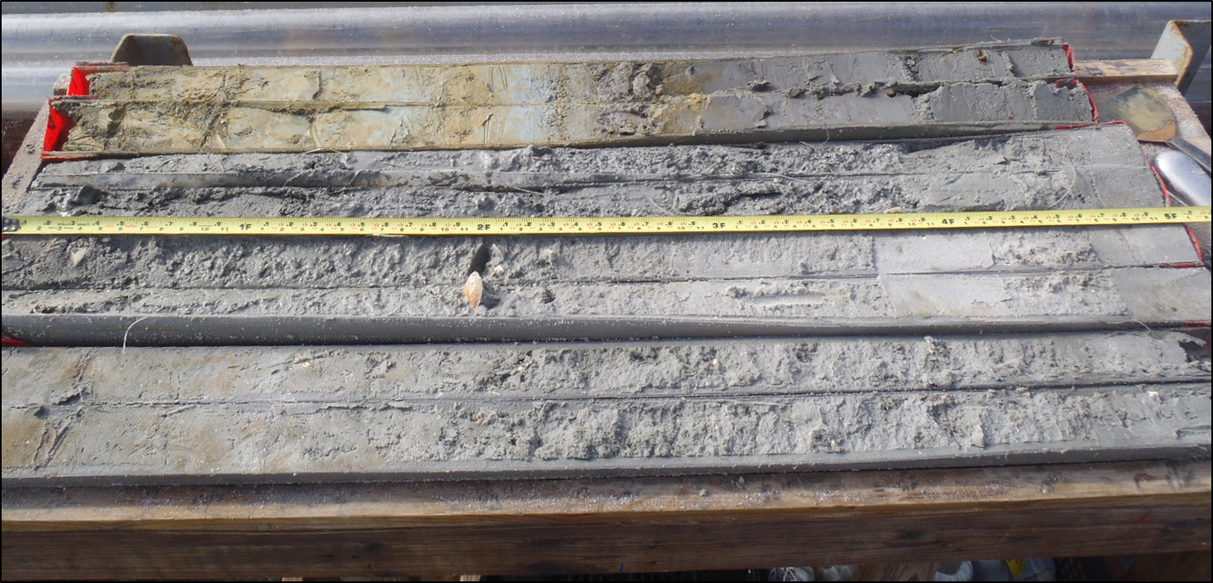
Fill Color
MS barrier island beaches are composed primarily of sand-sized quartz originating from the Appalachian Mountains.
Quartz content gives beaches a light gray to white color.
Dark minerals (mostly zircon, ilmenite, rutile, and monazite) are mixed with the quartz sand in certain areas of the beach, giving it an overall darker appearance.
Munsell Color classification (ASTM 1535) was used to categorize beach and borrow area samples.
Munsell “value” is the metric used for evaluating compatibility of borrow areas with native beaches. It quantifies the lightness of a sample on a scale of 0 (black) to 10 (white).
Native beaches are approximately Munsell value of 7.
Munsell value of 6 is considered acceptable for borrow areas because loss of fines during dredging and handling, combined with abrasive coastal processes after placement, will lighten the fill.
Vibracore taken during 2012 sampling event
Example Munsell Notation:
2.5y 6 / 1 Gray
Hue
Value
Chroma

Slide 12
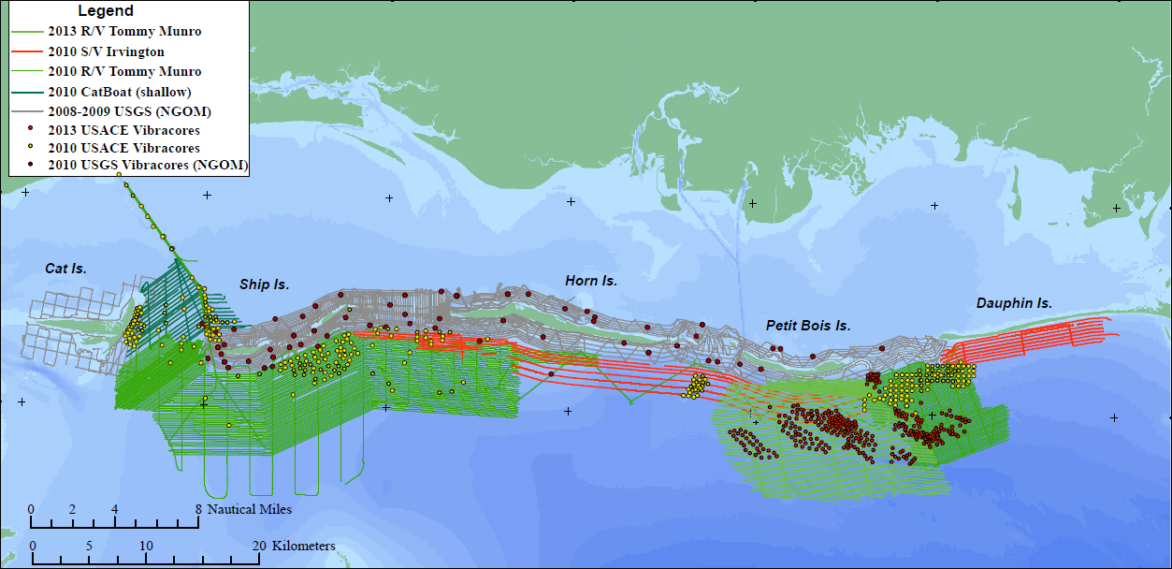
Geophysical and Geotechnical Investigations
USGS & USACE
USACE Vibracore Sampling 2010-2013
Sampling Event | No. of Vibracore Borings | No. of Lab Samples
2010 | 369 | 649
2011 | 89 | 176
2012 | 230 | 488
2013 | 206 | 455
Total | 894 | 1,768

Slide 13
Offshore Geology
USGS used their geophysical surveys and USACE vibracores to develop a better understanding of the geologic history and shallow stratigraphic succession of the project area while also mapping the major depositional features which might serve as potential sand sources for the project.
**Top Figure from: Open-File Report 2011-1173, “The Shallow Stratigraphy and Sand Resources Offshore of the Mississippi Barrier Islands”
Bottom Figure from: Open-File Report 2015-1014, “Near-surface stratigraphy and morphology, Mississippi Inner Shelf, northern Gulf of Mexico”

Slide 14
Offshore Geology, cont’d
Seafloor surface features in this area include shoals, tidal deposits, and material deposited from dredging activities.
Fine grain sands, silts, and clays are the dominant surface sediments.
Subsurface features in the USACE Barrier Island study area include sediments deposited in ancient river channels during the last sea-level lowstand, and deposits formed during the subsequent sea-level rise.

Slide 15
Offshore Geology, cont’d
The barrier islands, minus Cat Island, are slowly migrating from east to west as a result of natural erosion, transport, and deposition of the islands by the active transport zone within the littoral system.
The prevailing wave climate is southeast to northwest as indicated by major shoals in the area.
Seafloor surface features in this area include shoals, tidal deposits, and material deposited from dredging activities.
Fine grain sands, silts, and clays are the dominant surface sediments.
Subsurface features in the USACE Barrier Island study area include sediments deposited in ancient river channels during the last sea-level lowstand, and deposits formed during the subsequent sea-level rise.

Slide 16
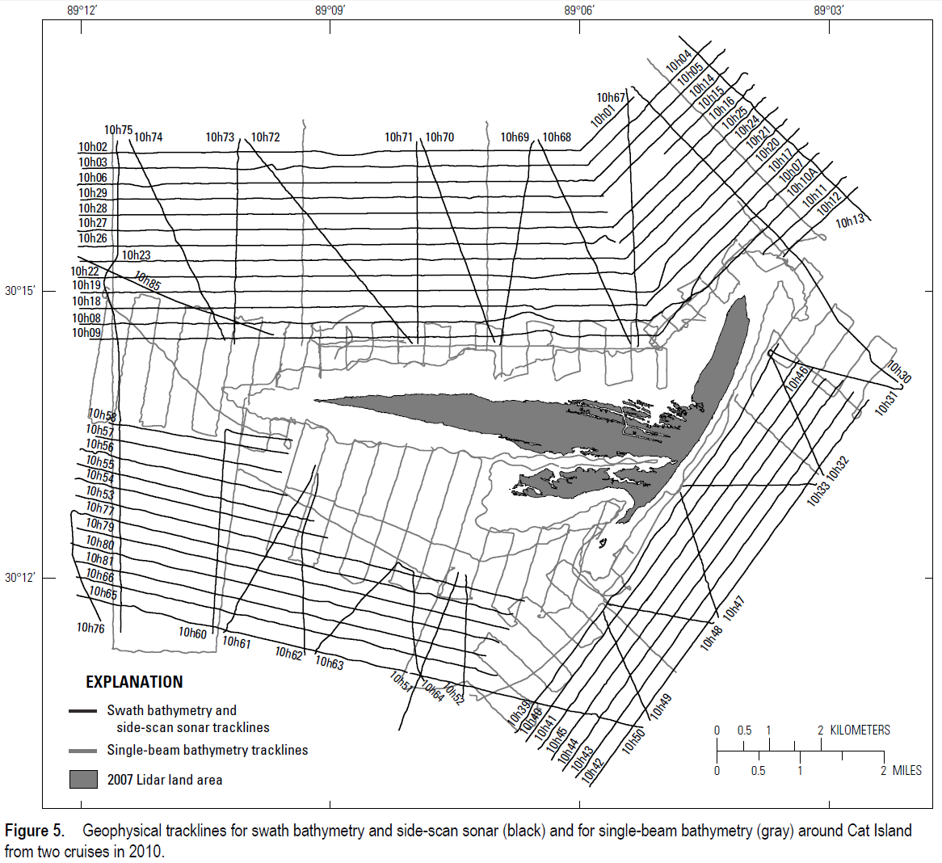
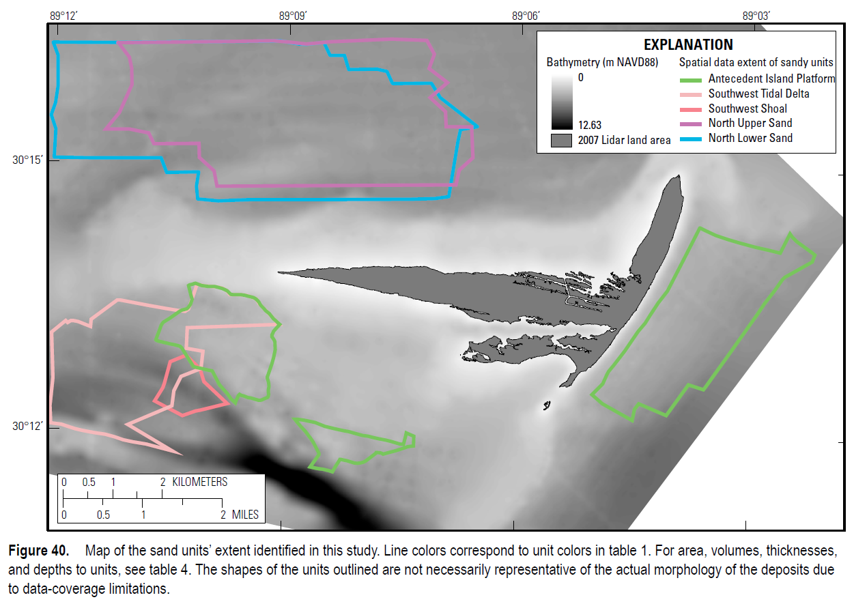
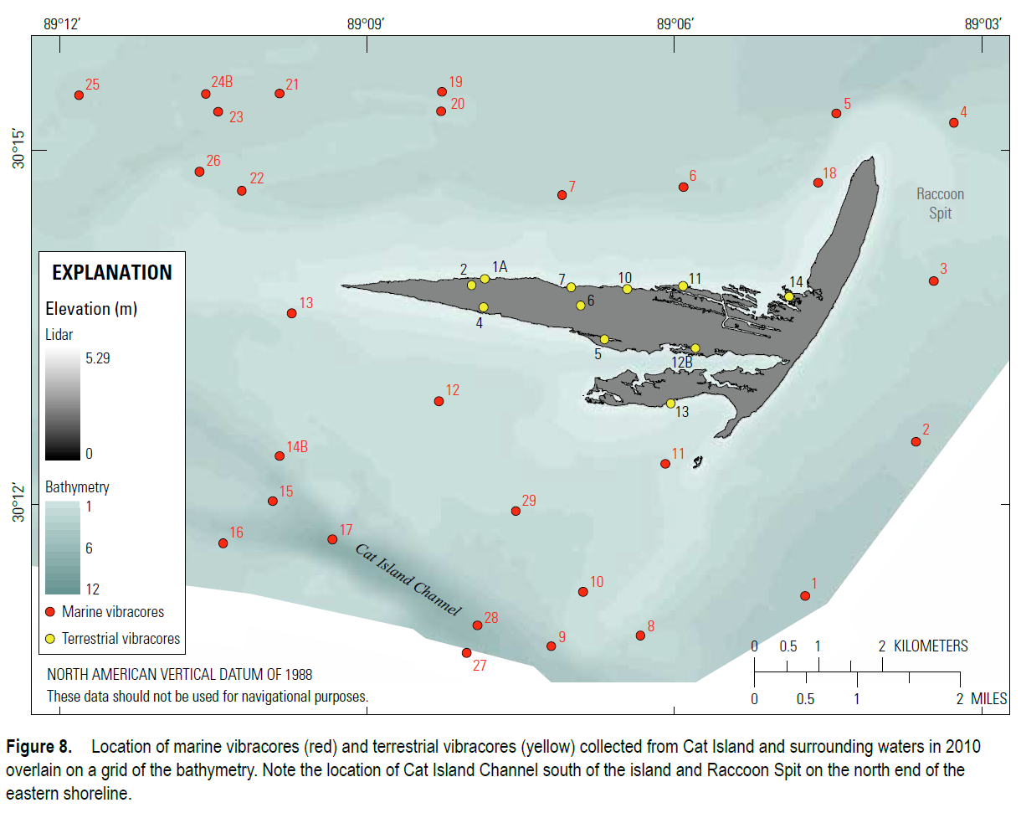
USGS Cat Island Morphology Study
Surveyed 487 line kilometers of high-resolution geophysical data around Cat Island
Collected 40 vibracores generating 350 samples for grain size analysis
Identified five (5) potential subaqueous sand resources
USACE’s Cat Island borrow area located within eastern Antecedent Island Platform (AIP) sandy unit (green outline) identified by USGS
**Figures from: Open-File Report 2014-1070, “The Shallow Stratigraphy and Sand Resources Offshore from Cat Island, Mississippi”

Slide 17
Fill Color
Munsell Color classification (ASTM 1535) was used to categorize beach and borrow area samples.
Munsell “value” is the metric used for evaluating compatibility of borrow areas with native beaches. It quantifies the lightness of a sample on a scale of 0 (black) to 10 (white).
Native beaches are approximately Munsell value of 7.
Munsell value of 6 is considered acceptable for borrow areas because loss of fines during dredging and handling, combined with abrasive coastal processes after placement, will lighten the fill.
Vibracore taken during 2012 sampling event
Example Munsell Notation:
2.5y 6 / 1 Gray
Hue
Value
Chroma

Slide 18
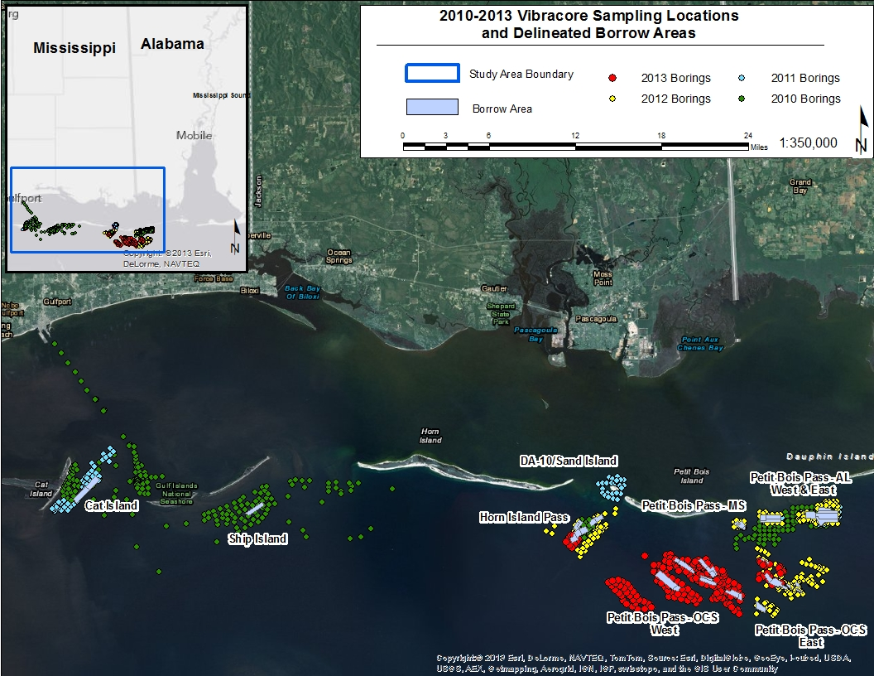
Geotechnical Investigations & Identified Borrow Sources

Slide 19
Borrow Area Quantities
Borrow Site | D50 (mm) | Required Dredge Volume (mcy) | Allowable Dredge Volume (mcy) | Haul Distance to Ship Island (miles)
Petit Bois Pass- AL East | 0.33 | 12.0 | 2.7 | 37
Petit Bois Pass- AL West | 0.31 | 3.9 | 1.2 | 34
Petit Bois Pass- MS | 0.31 | 1.6 | 0.4 | 32
Petit Bois Pass- OCS East | 0.29 | 3.0 | 1.2 | 35
Petit Bois Pass- OCS West | 0.27 | 10.4 | 5.3 | 31
Horn Island Pass | 0.29 | 2.8 | 2.1 | 23
Ship Island | 0.21 | 2.1 | 0.6 | 3
Cat Island | 0.20 | 2.9 | 1.4 | 1.5

Slide 20
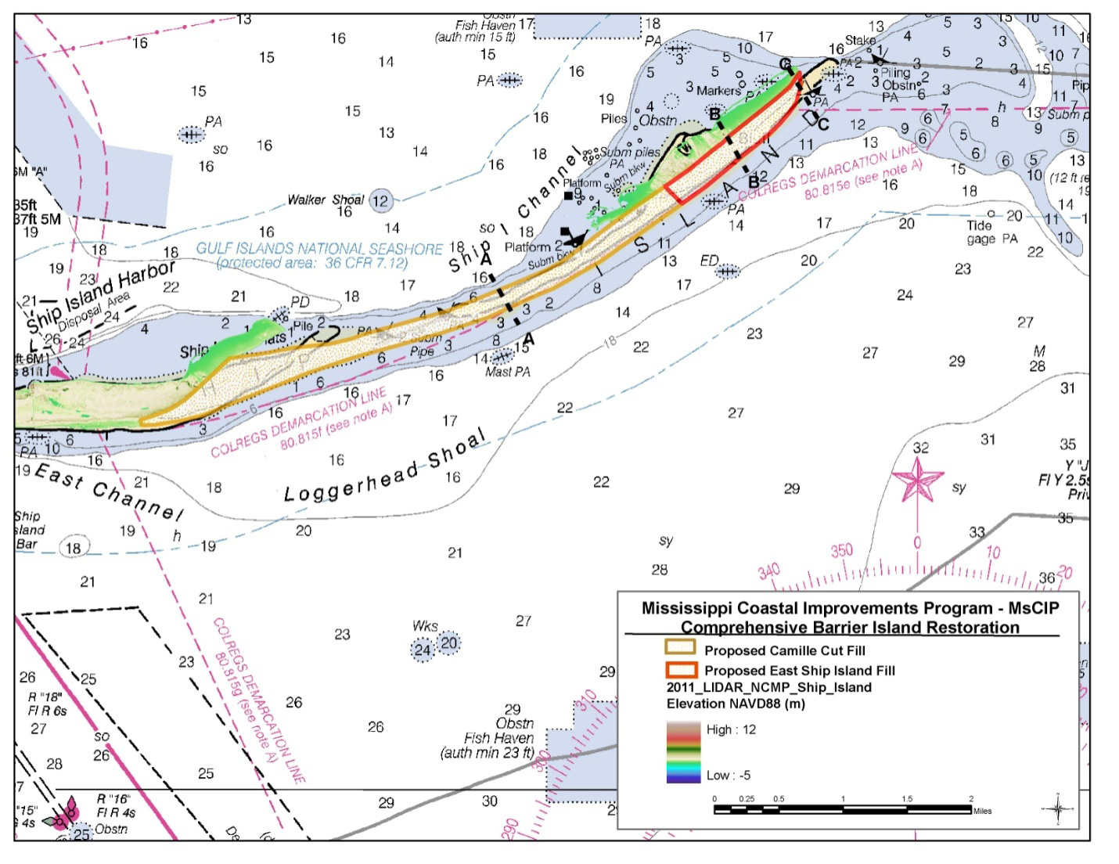
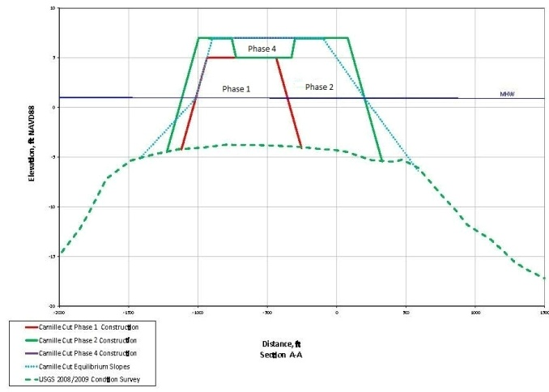
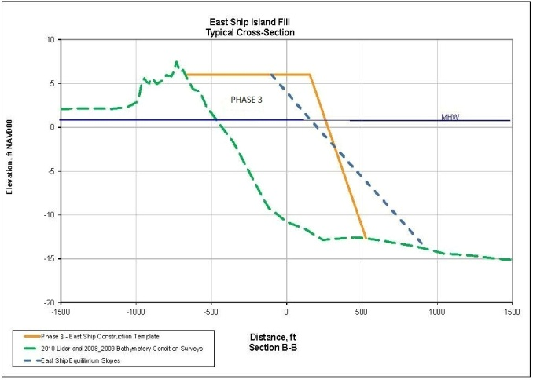
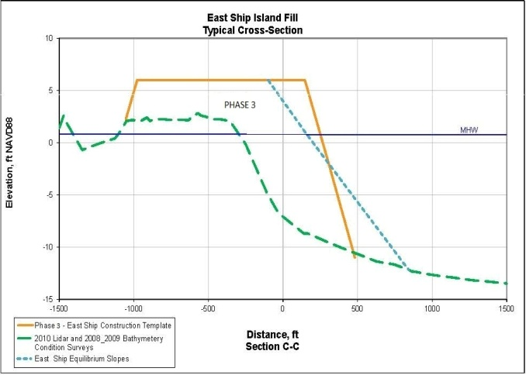
Recommended Plan for Ship Island Restoration

Slide 21
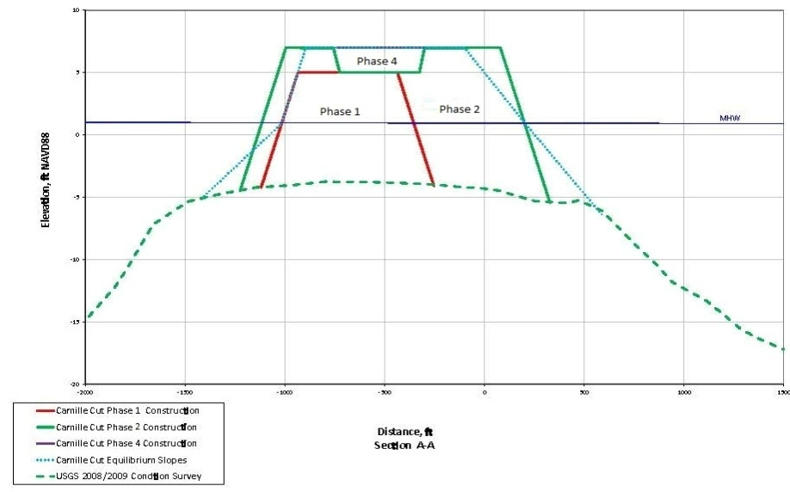

Ship Island Phases of Construction
Construction Phases
  Phase 1: (6.9 mcy)
    Initial closure of Camille Cut
    Top of Berm = EL. +5 ft NAVD88
    Crest Width = 500 ft
    Borrow Sites: PBP OCS East & West, HI Pass, & PBP MS
  Phase 2 (5.5 mcy)
    Widen and raise Camille Cut Fill
    Top of Berm = EL. +7 ft NAVD88
    Crest Width = 1,000 ft
    Borrow Site: PBP OCS West
  Phase 3 (5.5 mcy)
    East Ship Island
    Top of Berm = EL. +6 ft NAVD88
    Crest Width = 1,100 ft
    Borrow Sites: PBP OCS West & PB AL
  Phase 4 (1.1 mcy)
    Cap Camille Cut Fill
    Borrow Site: Ship Island

Slide 22
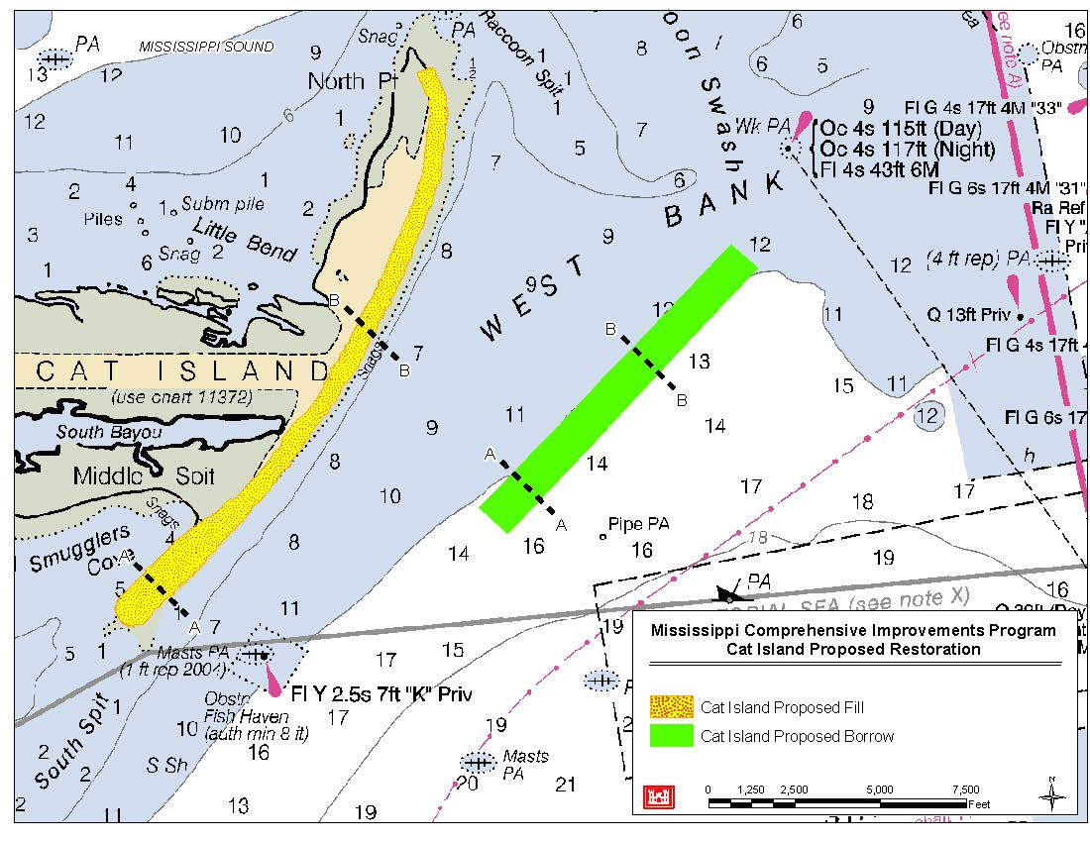
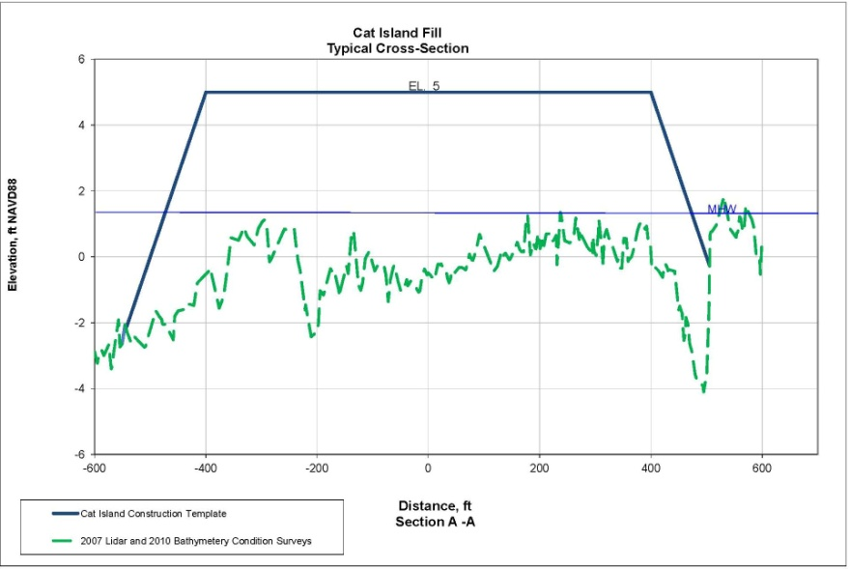
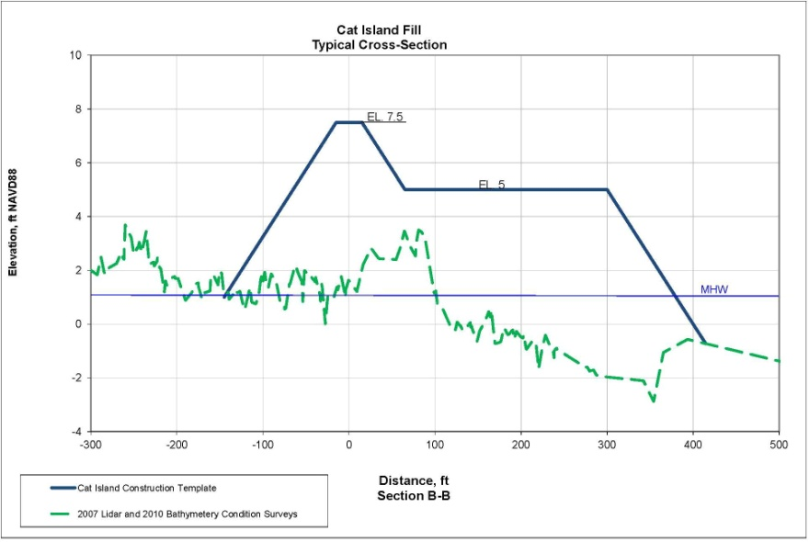
Tentatively Selected Plan for Cat Island
Placement Quantity = 2 mcy

Slide 23
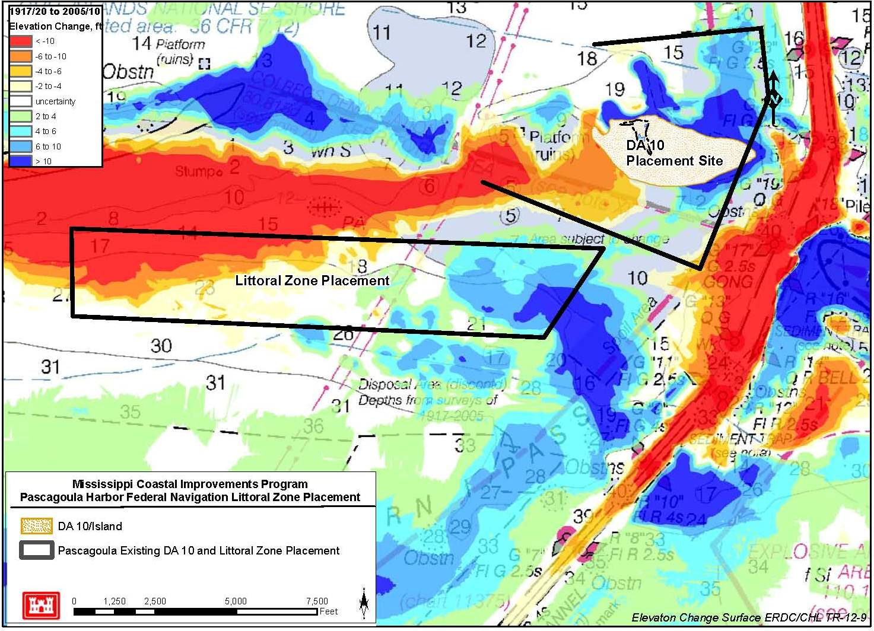
Existing Dredge Material Disposal Areas for Pascagoula

Slide 24
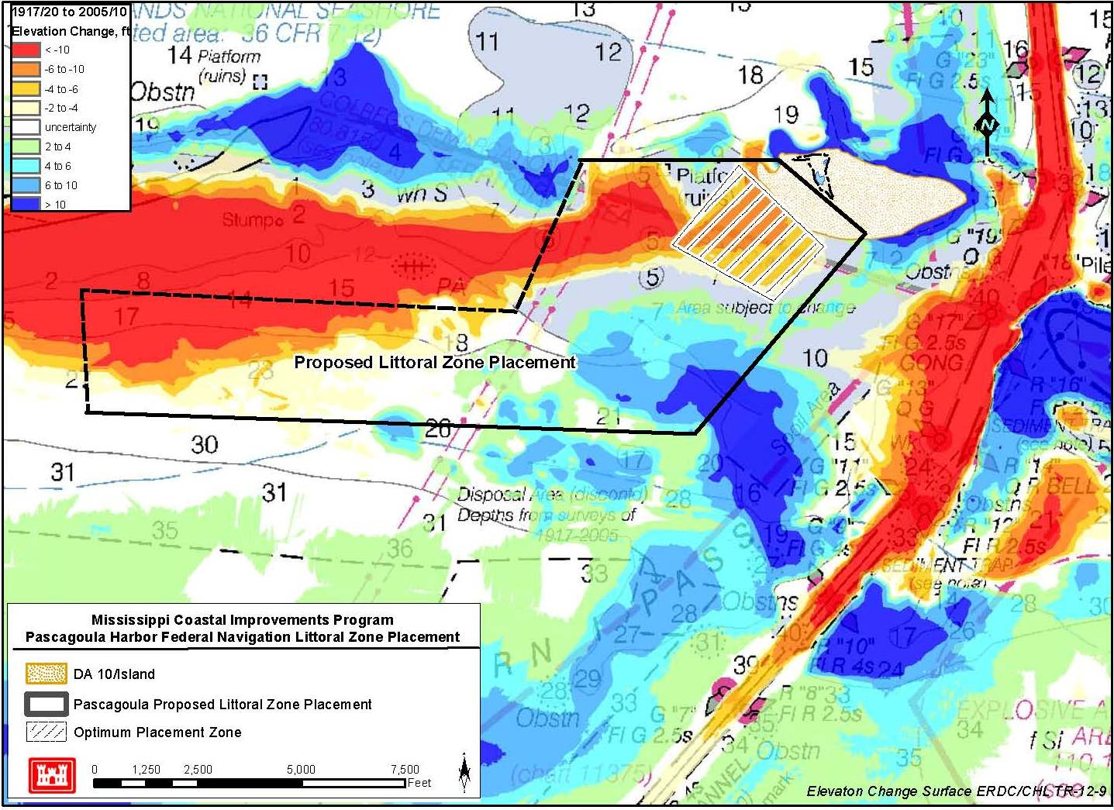
Proposed Modification to Dredge Material Disposal Plan

Slide 25
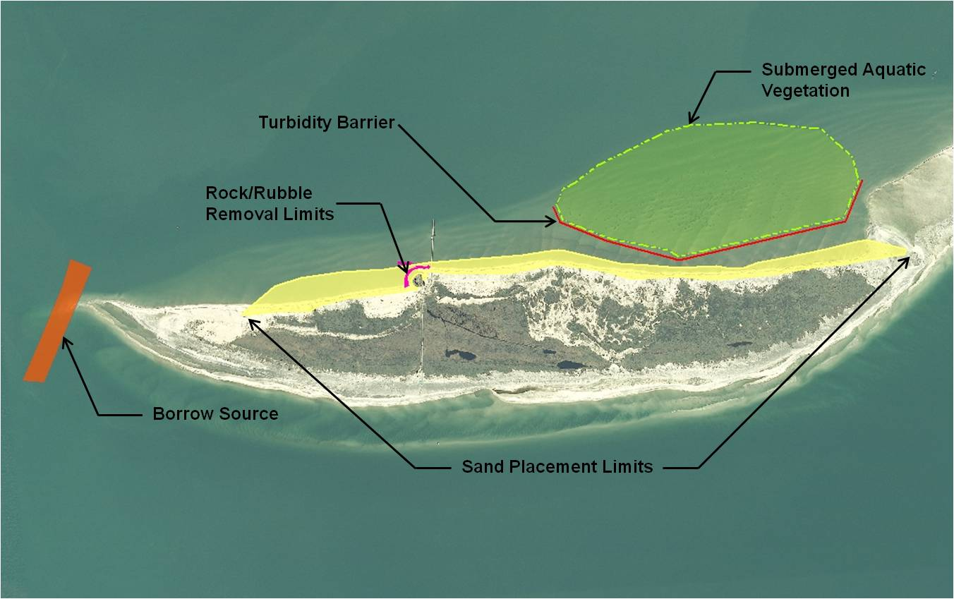
West Ship Island North Shore Restoration
Fill Volume: 565,000 cy
Berm Length: 9,700 ft
Project Cost: $7,219,501

Slide 26
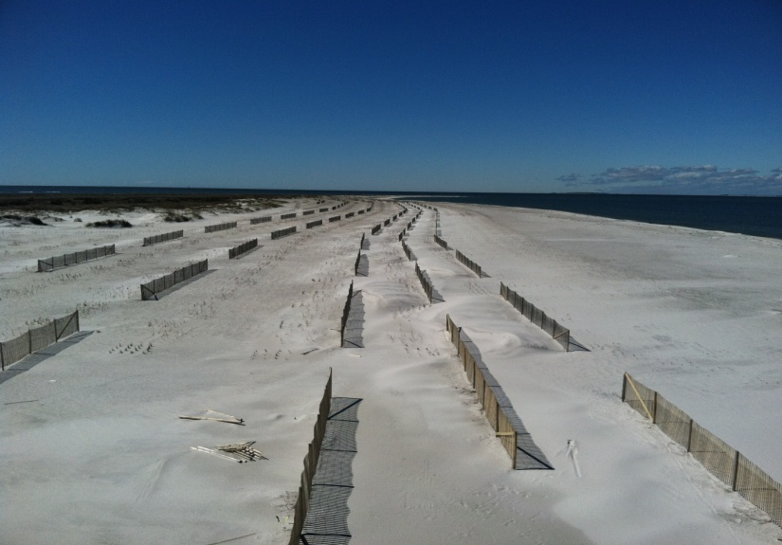
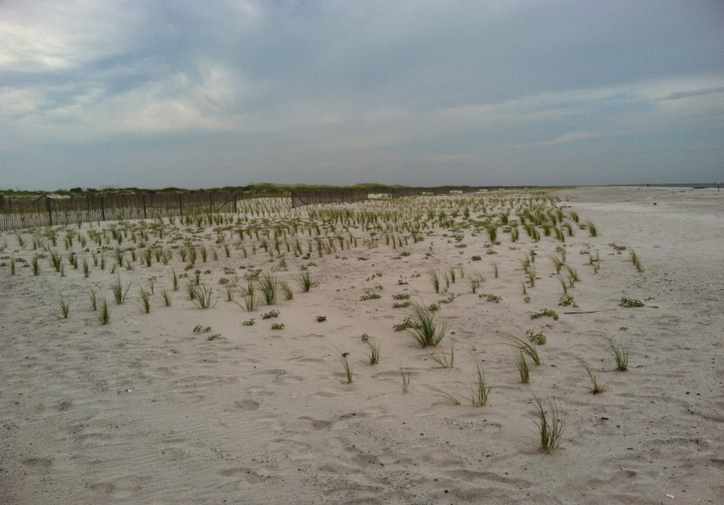
West Ship Island North Shore Restoration
Planting Phase
  Total of 272,604 plants installed
    Sea Oats
    Beach Panic Grass
    Maritime Bluestem
    Beach Tea
    Sea Purslane
  14,367 ft of sand fence
  Project Cost: $2,588,933

Slide 27
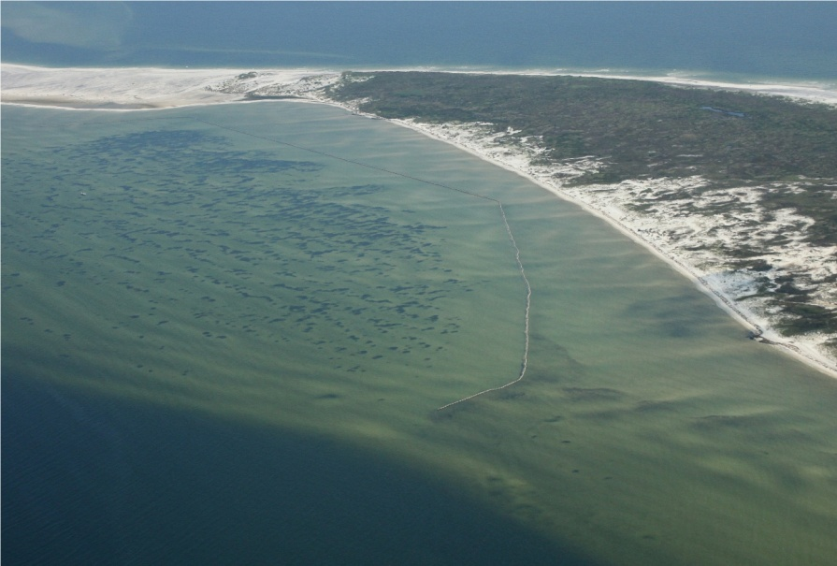
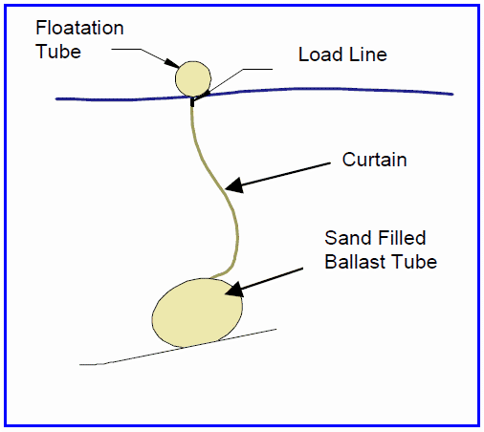
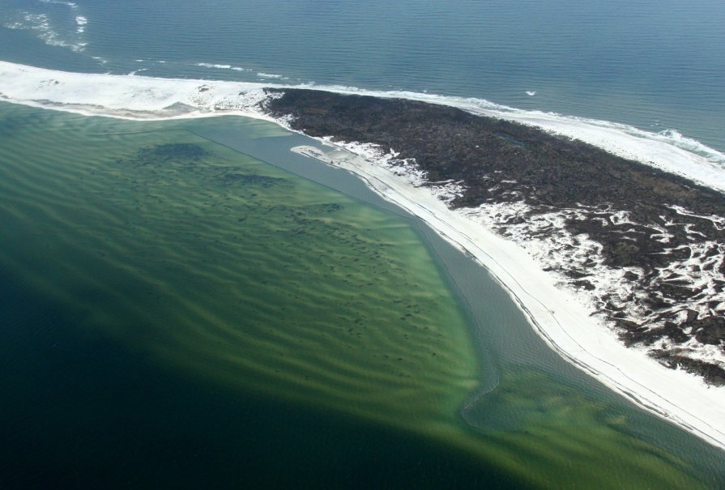
Protection of Submerged Aquatic Vegetation
Barrier System Details
  High strength woven fabric (same fabric used in geotubes)
  No chains/anchors
  Installed using small dive crew
Performance
  In place for 9 months with no failures
  Very effective protection measure

Slide 28
Summary of Overall Restoration Plan
MsCIP Comprehensive Barrier Island Restoration Plan was developed in response to Hurricane Katrina – 4 Components
  Objectives
    Restore the barrier islands structure to reduce storm damage impacts on the mainland coast of Mississippi.
    Enhance the long-term littoral drift system for the Mississippi barrier islands.
    Maintain the estuarine ecosystem and resources of the Mississippi Sound.
    Preserve the natural and cultural resources of the Mississippi barrier islands.
  Restore Sediment Budget
    Placement Locations – Camille Cut/East Ship Island
    Borrow Sources – Petit Bois Pass AL, Petit Bois Pass MS, Petit Bois Pass OCS East, Petit Bois Pass OCS West, Horn Island Pass, and Ship Island
    Recommended Plan – 13.5 mcy in Camille Cut & 5.5 mcy at East Ship Island
  Restore Eastern Shoreline of Cat Island
    Placement of 2 mcy along eastern shoreline
    Borrow Source – Cat Island
  Revise Dredge Material Disposal Plan for Pascagoula Navigation Channel
  Restore Northern Shoreline of West Ship Island (Complete)

Slide 29
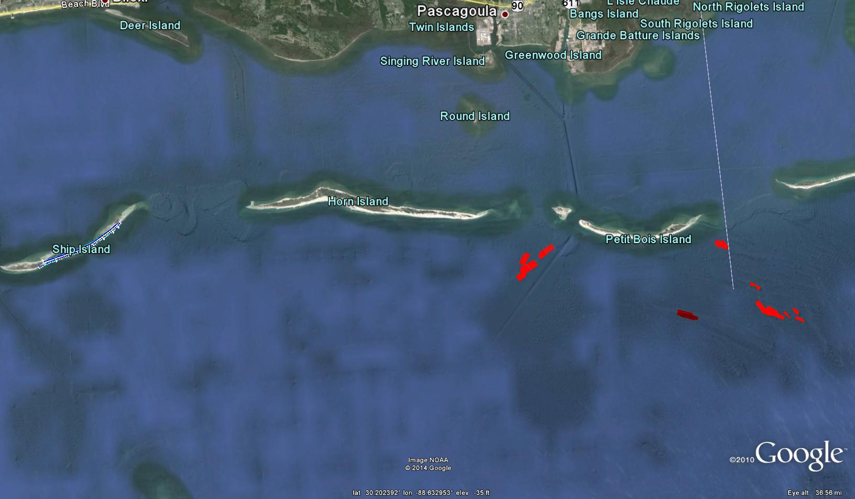
Ship Island Restoration – Phase 1
Placement Site
HI Pass
PBP MS
PBP OCS West 4
PBP OCS East
Borrow Sites

Slide 30
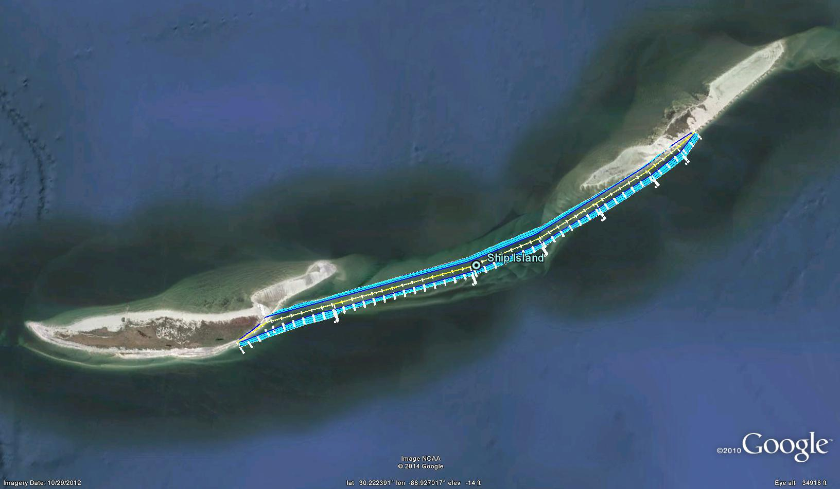
Phase 1 Placement Site Details
Total In-Place Quantity = 6.9 mcy
Total Berm Length = Approx. 24,650 ft
Berm Crest Width / Elevation = 500 ft / +5 ft NAVD88
Berm Side Slopes:
  Above MHW = 1V:12H
  Below MHW = 1V:20H

Slide 31
Contract Highlights
Bid Schedule / Measurement & Payment
  Mob & Demob – Standard 60% / 40% contract language
  Breach Fill – Payment based on in-place quantity measured from the before vs after construction surveys (tolerance of +/- 0.5 ft.) for 200 ft acceptance sections
    Not required to construct underwater side slopes. Allowed to stockpile fill above tolerance upslope of the slough zone.
    Partial progress payments will be allowed for last 5,000 ft of breach closure.
    If contractor leaves the job, will deduct 2,000 c.y. x unit price + $7 per c.y. per day from the bid item. No deduction for work stoppages due to weather and/or short mechanical failures not exceeding 7 days.
    Required to excavate quantity equal to volume in the required template. 2 ft of allowable overdepth provided.
  Trawling – Paid per day. Mob & demob equal to one day of trawling each.
    At the discretion of USACE but, at a minimum, required for first 12 hours prior to dredging and initial 7 days of work in each borrow area.
Access
  Must use access corridors shown on contract drawings. No exceptions unless approved by Contracting Officer.
Additional Environmental Requirements
  Daily shorebird and sea turtle monitoring for nests required during season
  Must adhere to nesting closure areas (including eagles and osprey)
  USACE will install and maintain turbidity barriers around SAVs through separate contract but dredging contractor is responsible for ensuring all WQ requirements are met.

Slide 32
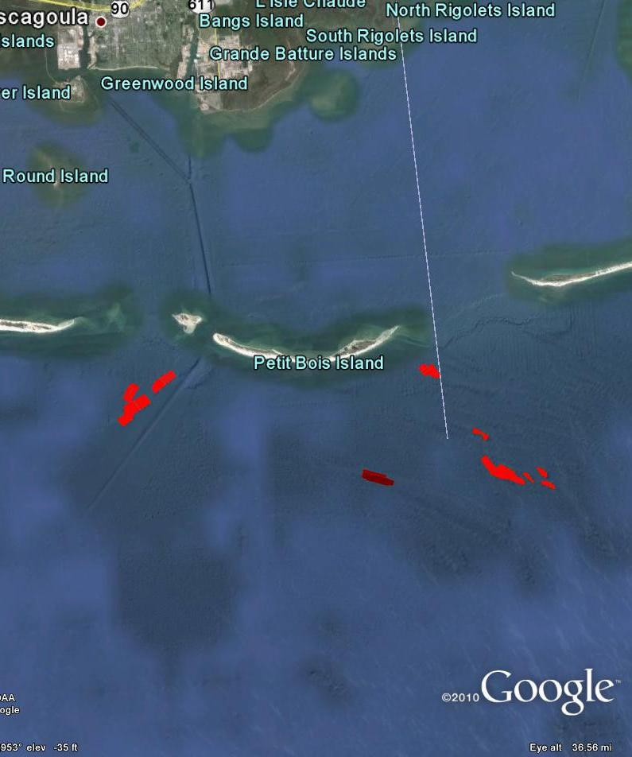
Phase 1 Borrow Area Details
HI Pass
  Available Required & Allowable OD Volumes = 2.8 mcy; 2.1 mcy
  Total In-place Volume = 2.2 mcy
  Required Dredge Elevations = -33 to -39 ft NAVD88
  Avg Cut Thickness = 4 ft; Avg D50 = 0.29 mm; Avg fines = 4%;
  Avg Haul Distance to Ship Island = 23 miles
PBP MS
  Available Required & Allowable OD Volumes = 1.6 mcy; 0.4 mcy
  Total In-place Volume = 1.3 mcy
  Required Dredge Elevations = -31.5 to -45.5 ft NAVD88
  Avg Cut Thickness= 6 ft; Avg D50 = 0.31 mm; Avg fines = 3%
  Avg Haul Distance to Ship Island = 32 miles
PBP OCS East
  Available Required & Allowable OD Volumes = 3.0 mcy; 1.2 mcy
  Total In-place Volume = 2.3 mcy
  Required Dredge Elevations = -49.5 to -61.5 ft NAVD88
  Avg Cut Thickness = 4 ft; Avg D50 = 0.29 mm; Avg fines = 2%
  Avg Dist to Ship Island = 35 miles
PBP OCS West 4
  Available Required & Allowable OD Volumes = 1.8 mcy; 0.6 mcy
  Total In-place Volume = 1.2 mcy
  Required Dredge Elevations = -49 to -62.5 ft NAVD88
HI Pass
PB MS
PB OCS East
PB OCS West 4
    Avg Cut Thickness = 8 ft; Avg D50 = 0.30 mm; Avg fines = 4%
    Avg Dist to Ship Island = 31 miles

Slide 33
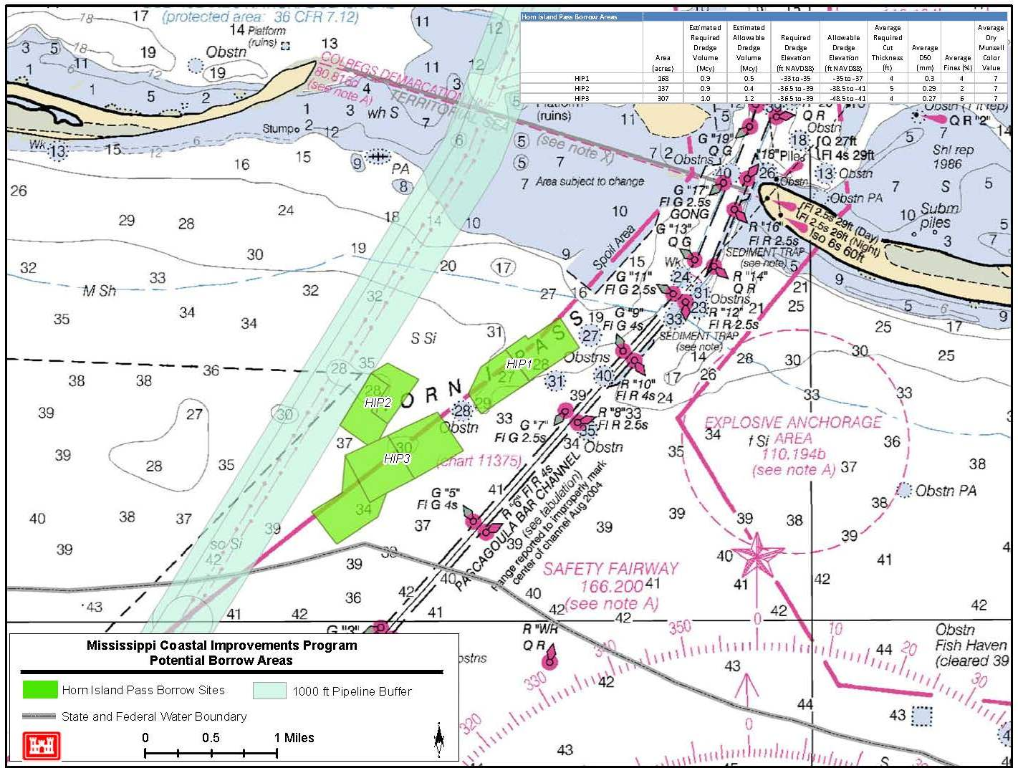
Horn Island (HI) Pass Borrow Area

Slide 34
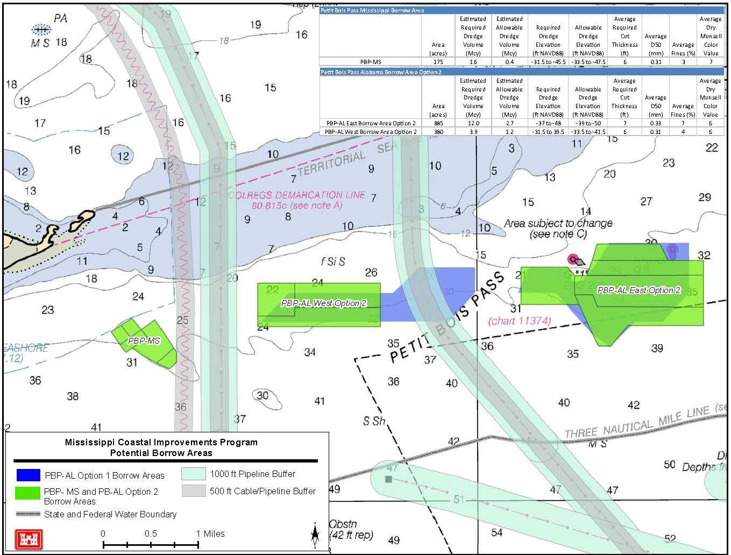
Petit Bois Pass (PBP) MS Borrow Area

Slide 35
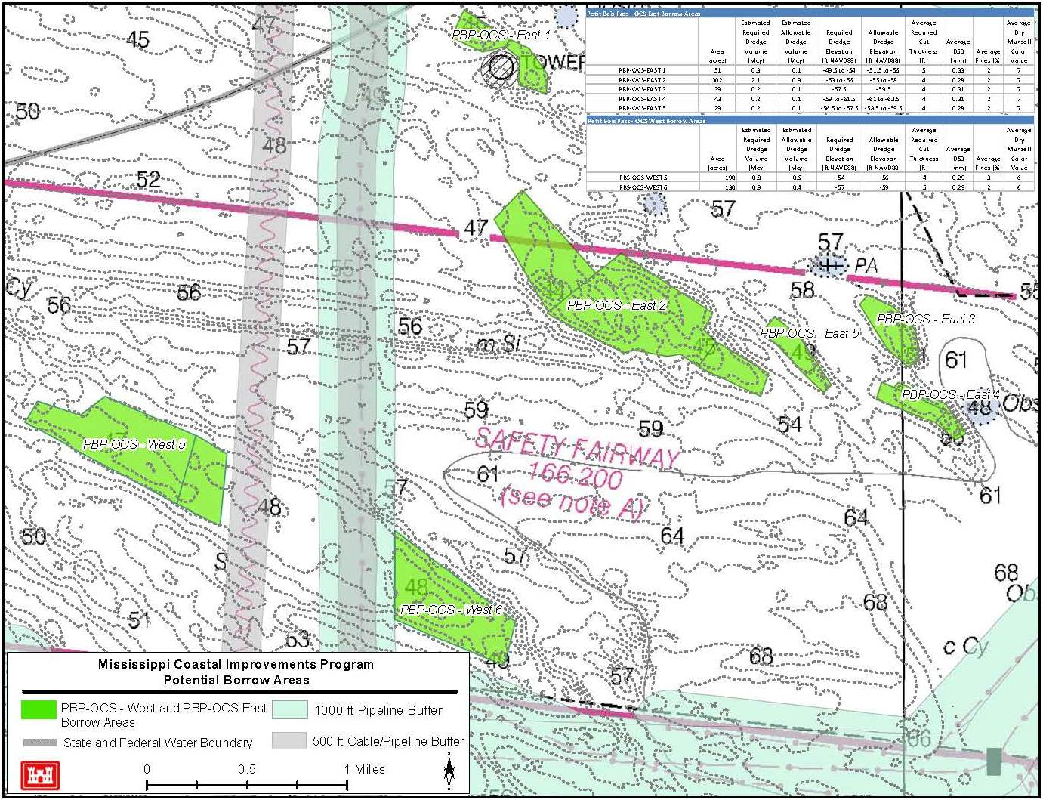
Petit Bois Pass (PBP) OCS East Borrow Area

Slide 36
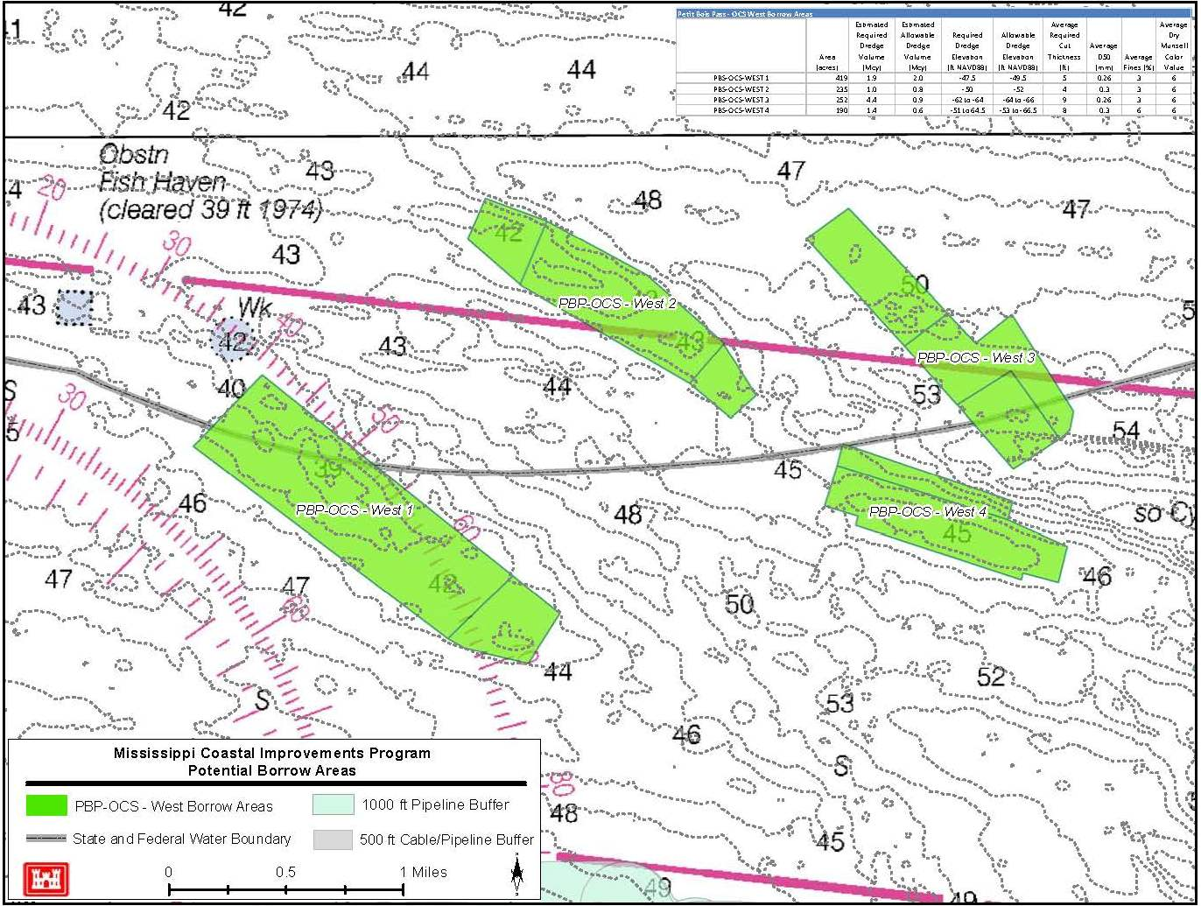
Petit Bois Pass (PBP) OCS West 4 Borrow Area
Only PBP OCS West 4 will be used in Phase 1

Slide 37
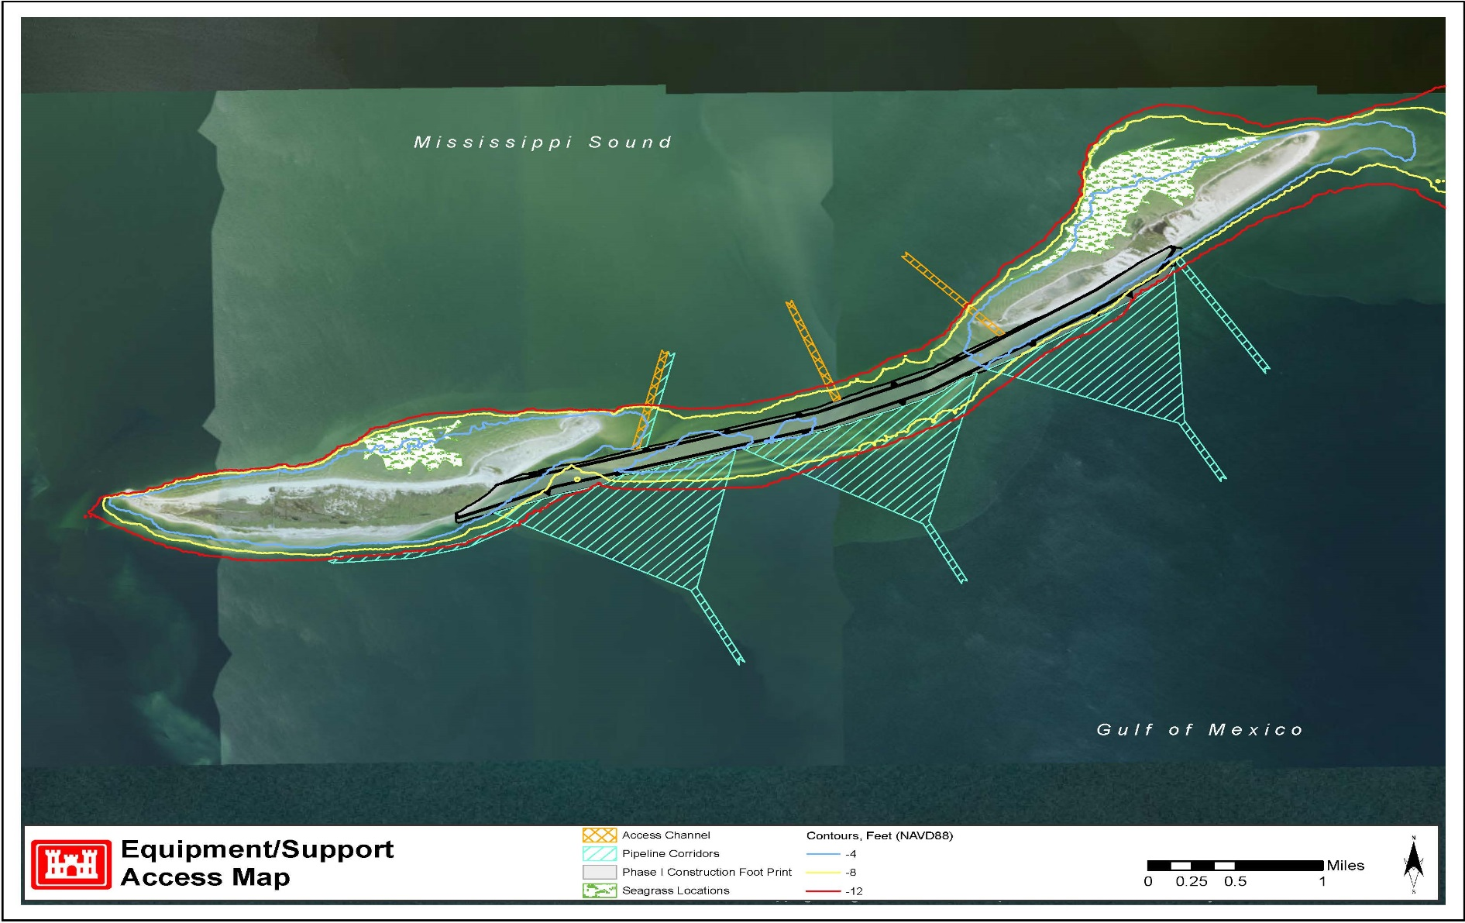
Construction Access for Phase 1

Slide 38
Environmental & Cultural Resource Considerations
Sea Turtle & Gulf Sturgeon Observer/Trawler Requirements During Dredging
  24 hr coverage by observers on hopper dredges.
  When and where to trawl will be decided by the Mobile District. Deflectors will be required on hopper dredge drag-arms.
  Dredging suspends immediately if (a) two or more turtles are taken within 24 hour period, (b) four turtles are taken during dredging, or (c) one Gulf sturgeon is taken during dredging.
Monitoring of Sea Turtles Nests at the Placement Site
  Daily monitoring will be required from April 15 – November 30 by qualified personnel. Monitoring can be performed using ATVs or UTVs and will be required within 100 days of where work will occur.
  If a nest is found, it must be relocated by 9:30 a.m. the same day to an area that will be identified on either East or West Ship Island.
  Only State of Mississippi permitted personnel are eligible to relocate sea turtle nests. A permit must be obtained from the Mississippi Museum of Natural Sciences in coordination with U.S. Fish and Wildlife Service.
Protection of Nesting Shorebirds
  Daily monitoring/surveys of nests will be required from March 1 – September 30.
  Monitoring will be performed during afternoons. Temporary 300-foot buffer zones will be created around any nesting birds. The use of ATV or UTVs is permitted outside of the buffer areas. All nests located near construction areas shall be noted and signage placed.
  Monitoring surveys shall note the presence of wintering migrants, specifically piping plover, red knots, colonial, and solitary nesting birds.

Slide 39
Environmental & Cultural Resource Considerations
Protection of Wintering & Migratory Shorebirds
  Weekly surveys will be required from July 15 – May 30 noting the presence and behavior of Piping plover, Red Knot, and other wintering or migratory shorebirds.
Access corridors and staging areas
  Access corridors are provided on the contract drawings and staging areas shall be contained within the beach template.
  Nesting closure areas will be posted by the National Park Service (NPS) and must be adhered to.
Protection of Manatees
  Standard manatee construction conservation measures will be required.
Reporting Requirements to USACE Planning Division – Coastal Environments Section
  Weekly reporting of sea turtle nesting surveys will be required (email is acceptable).
  Results of daily shorebird monitoring and nesting activities shall be forwarded weekly.
  Summary of shorebird and sea turtle nesting will be required within 30 days of project completion.
The use of ODESS (Operations and Dredging Endangered Species System) is required when completing dredge load data reports, marine mammal observations, and sea turtle/gulf sturgeon incident forms.

Slide 40
Environmental & Cultural Resource Considerations
Protection of Submerged Aquatic Vegetation (SAV)
  USACE will install turbidity barriers through a separate Environmental Services contract to protect the SAVs north of West and East Ship Islands.
  The turbidity barriers will remain in place and be maintained by the Environmental Services contractor throughout the life of the Phase 1 contract.
  Phase 1 contractor will be responsible for monitoring the turbidity levels in the vicinity of the SAVs and ensuring they remain within the acceptable range (50 NTU above ambient).
Water Quality
  Mixing zone at the placement site is 750 ft with a 50 NTU above ambient limit outside of the zone. Reasonable exceedance is allowed.
Cultural resource sites are present within the Phase 1 construction template
  Quarantine Station site on west end of East Ship Island.
  This island has had periods of human occupation dating back thousands of years, consequently an inadvertent discoveries plan will be provided to the contractor which outlines notification chain and protocols for discovering any potential cultural resources.
Sand Placement Requirements on Quarantine Station Site
  USACE will provide a Cultural Resource Plan of Action that identifies the requirements and protocols when working around these sites.
  At a minimum, 2 ft of sand will be required to be placed over the sites before
  equipment is allowed on top.

Slide 41
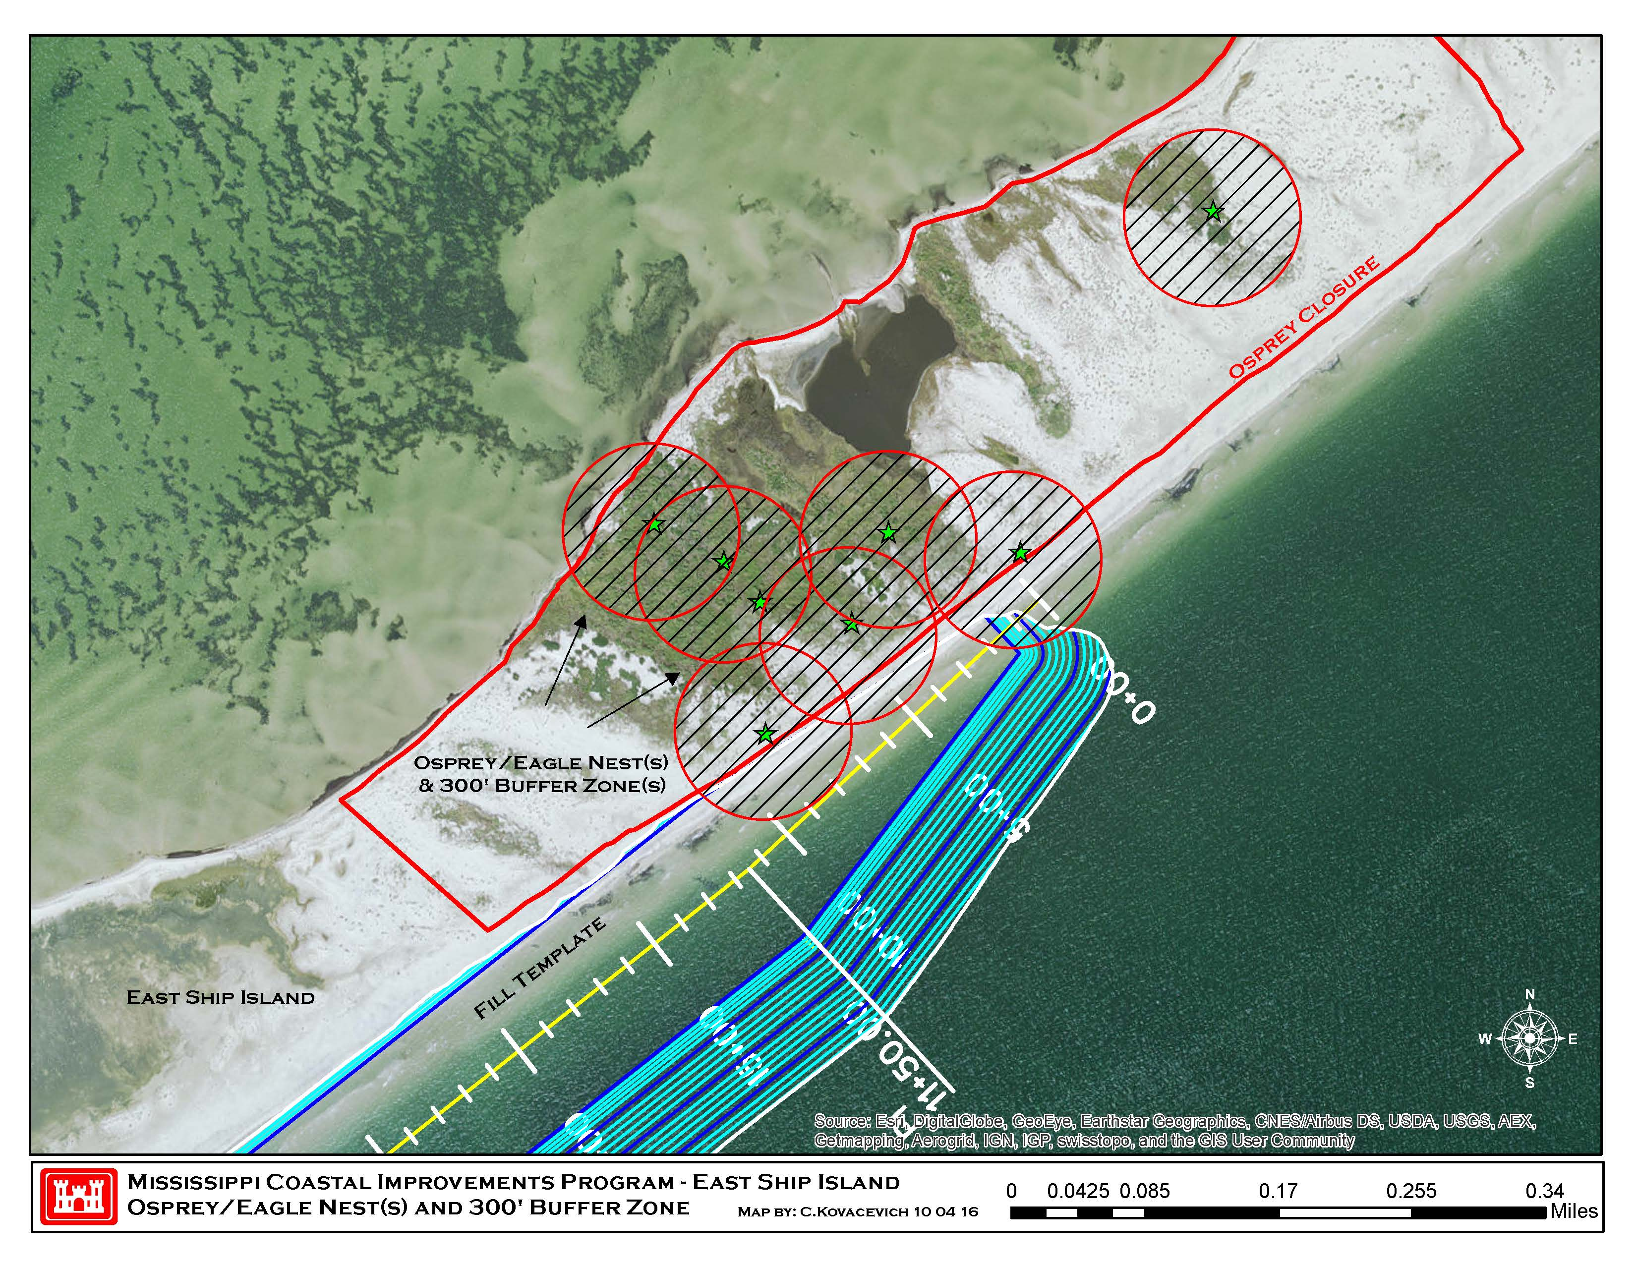
Eagle & Osprey Closure Areas

Slide 42
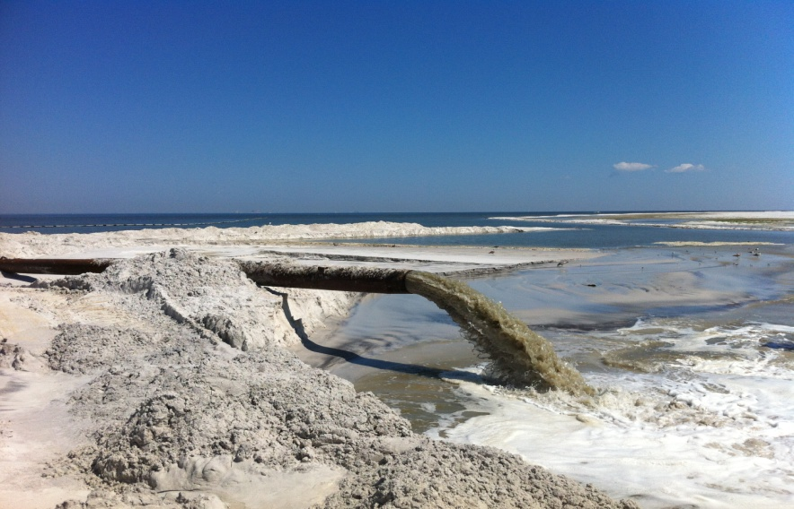
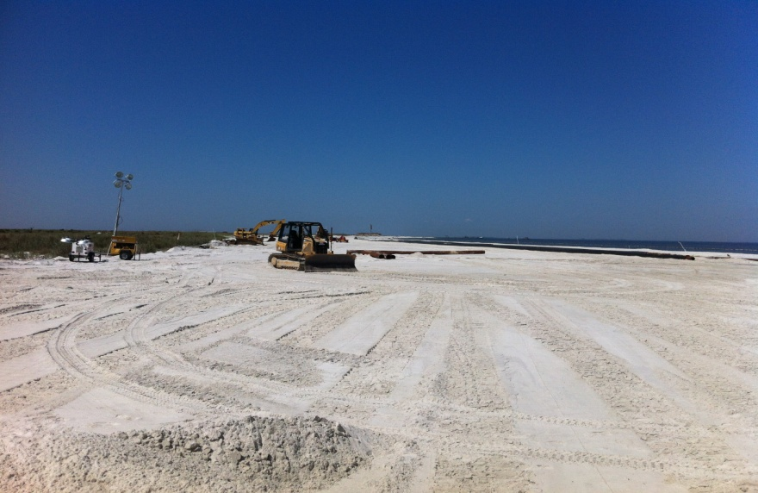
Contracting Timeline for Phase 1
Phase 1 will be a “C” type Invitation for Bid (IFB) contract
  Advance Notice: late-October
  Advertise: late November
  Bid Opening : late December
  Contract Award: mid-January
  Period of Performance : 15 months

Slide 43
Summary of Phase 1 Project
Scope:
  Total quantity of 6.9 mcy in-place at Camille Cut/East Ship Island
  Four borrow areas (HI Pass, PBP MS, PBP OCS East, and PBP OCS West) with a total available required quantity of 9.2 mcy and allowable overdepth quantity of 4.3 mcy
  Specific construction access and pipeline corridors are provided at various locations along the project
Environmental & Cultural Resource Considerations
  Trawling required for all borrow areas for first 7 days of work. At USACE discretion afterwards.
  Daily shorebird and sea turtle monitoring for nests required during season
  USACE will install and maintain turbidity barriers around SAVs through separate contract
  USACE will provide plan of action for cultural resource sites within project footprint
Contracting Timeline
  Advertise: late November
  Bid Opening / Contract Award : late December / mid-January
  Period of Performance : 15 months

Slide 44
QUESTIONS??

Slide 45












